Slide 1
Where is my……?
Take out your book, and turn to P53. Prepare one color pen for taking notes.

Slide 2
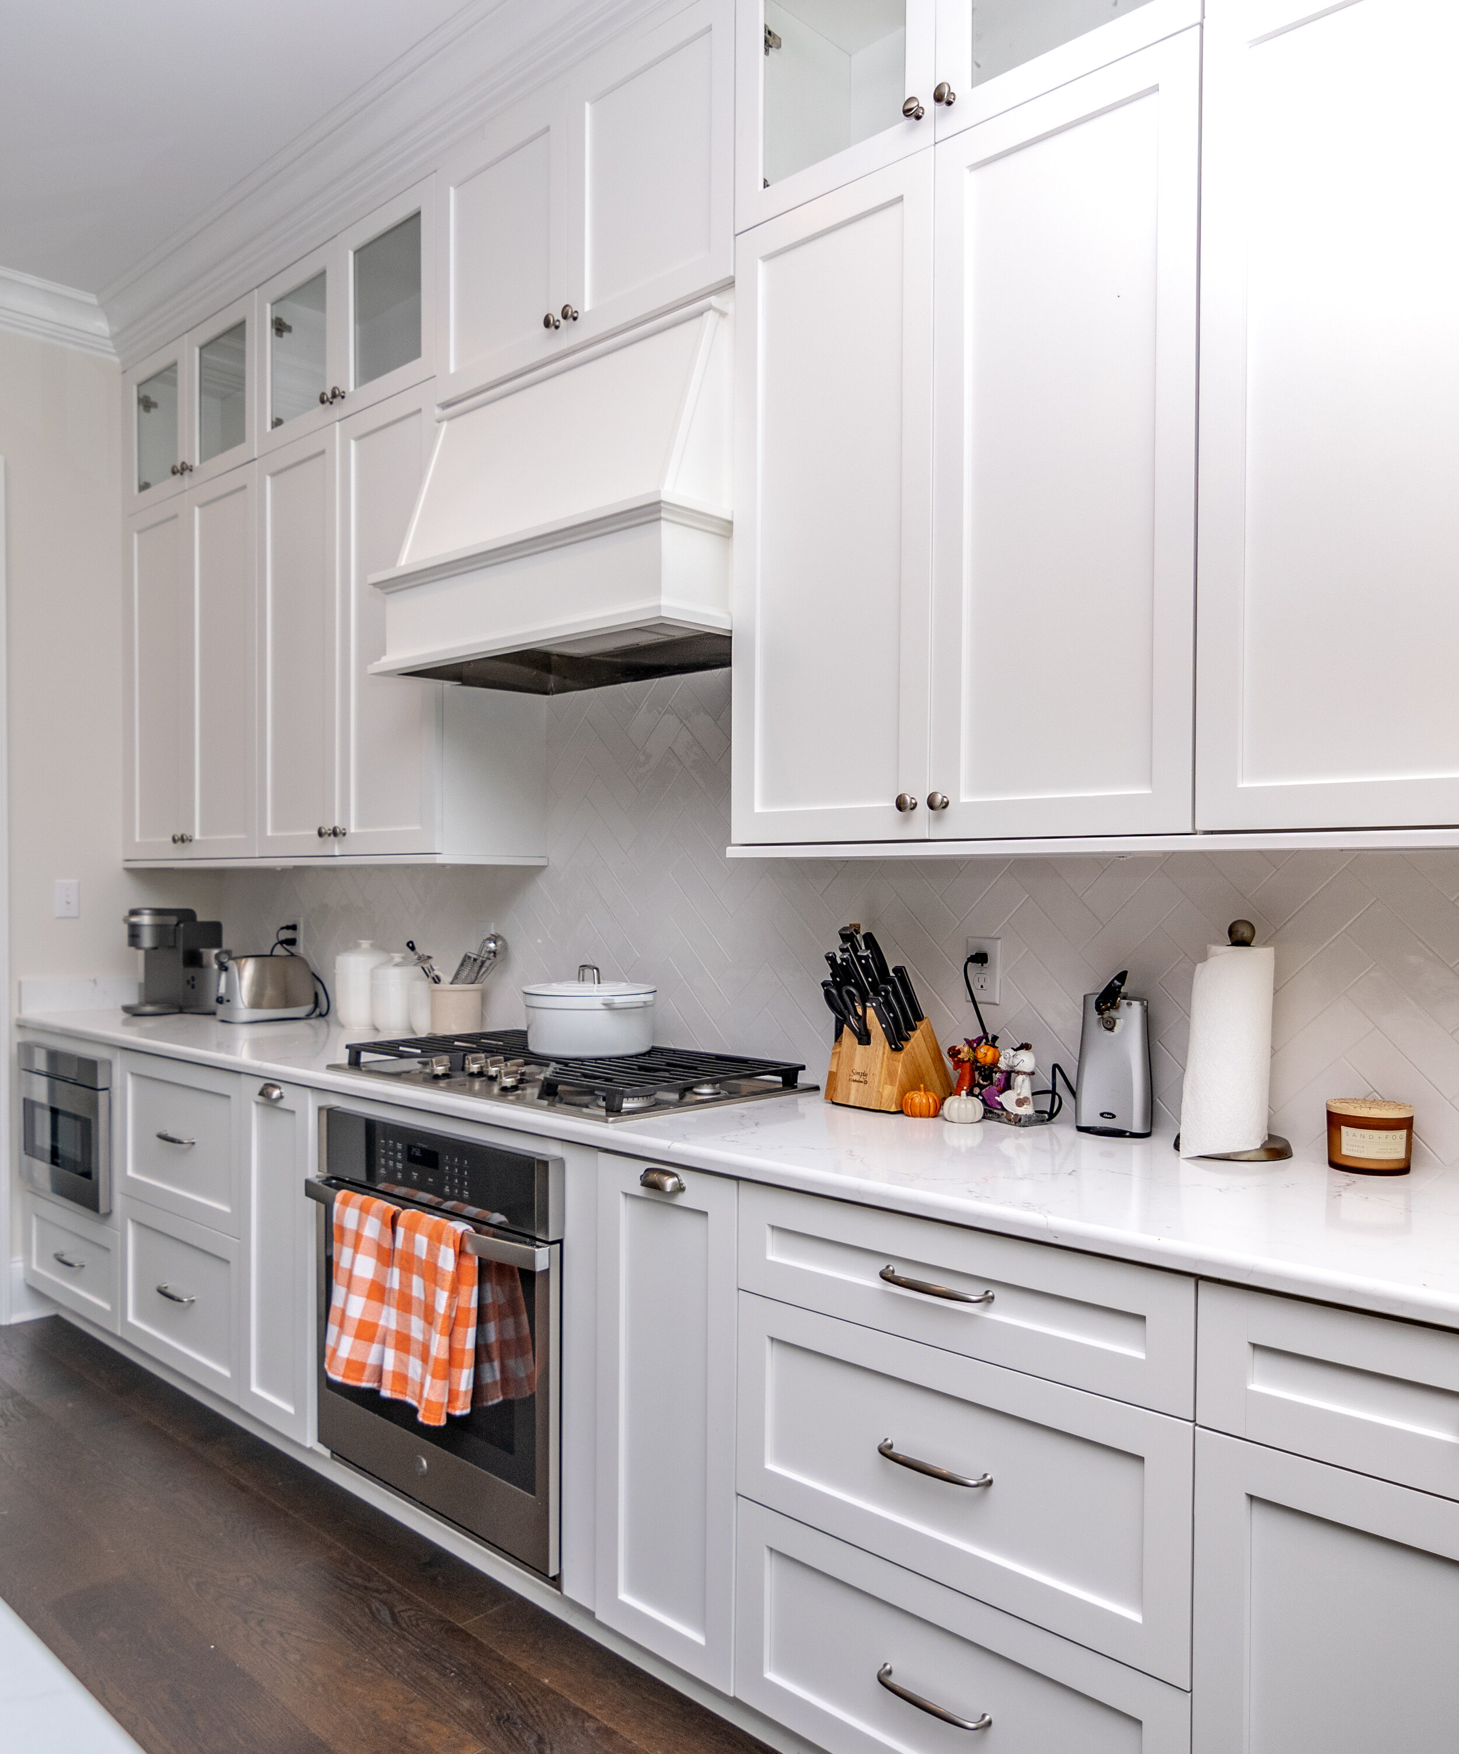
Where is my cleaner?
It’s in the kitchen.
It looks like a whale.

Slide 3
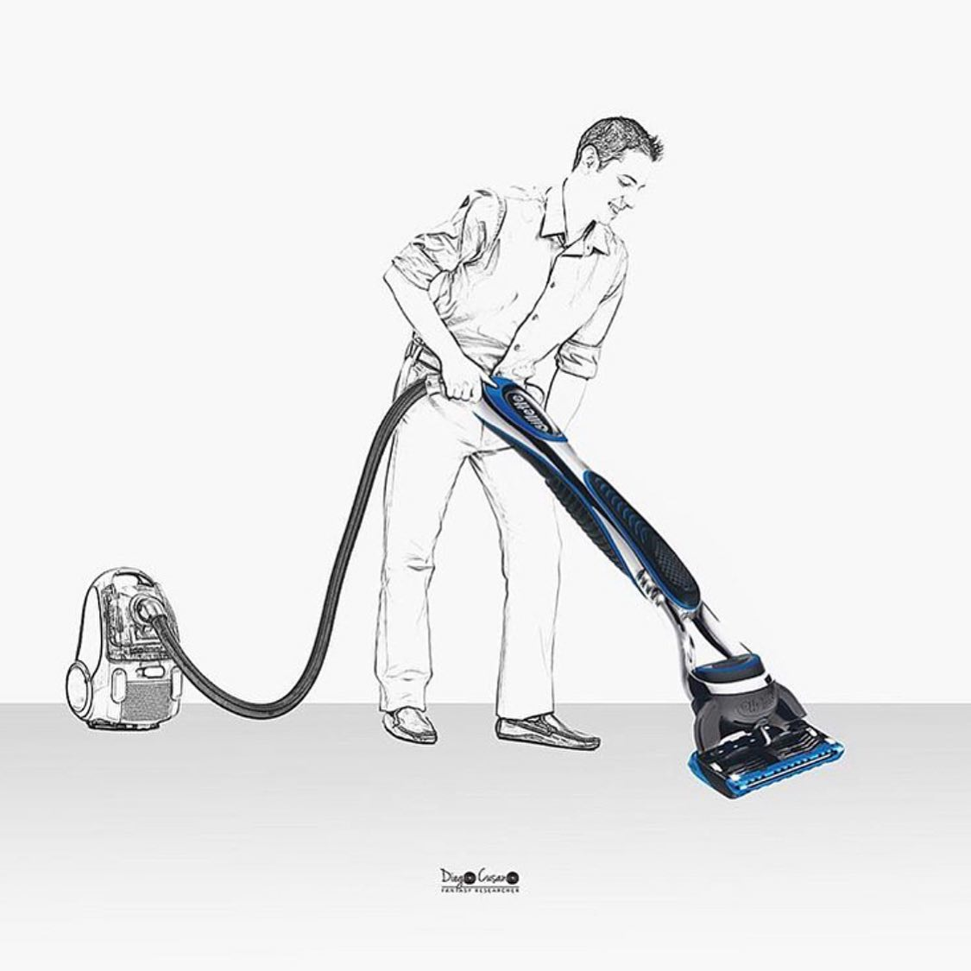
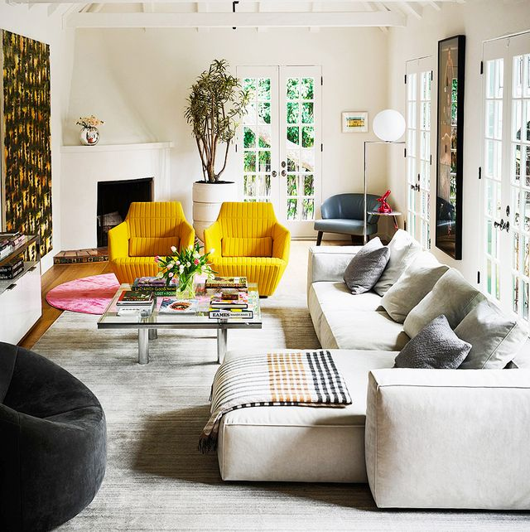
Where is my razor?
It’s in the living room.
It looks like a vacuum machine.

Slide 4
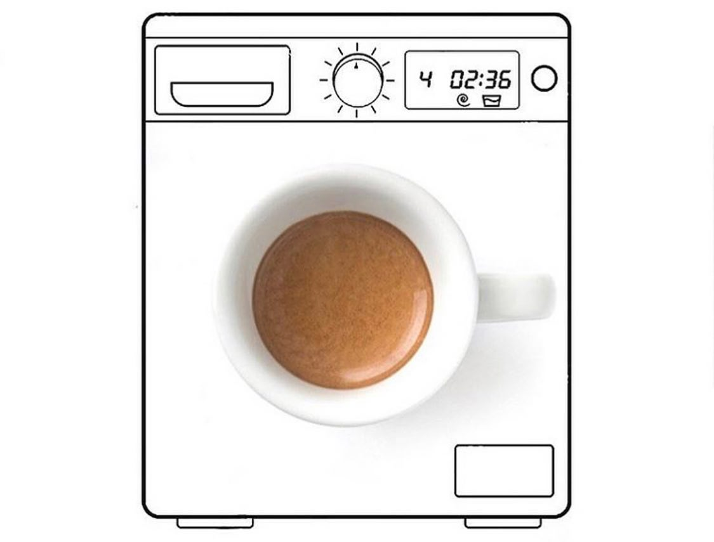
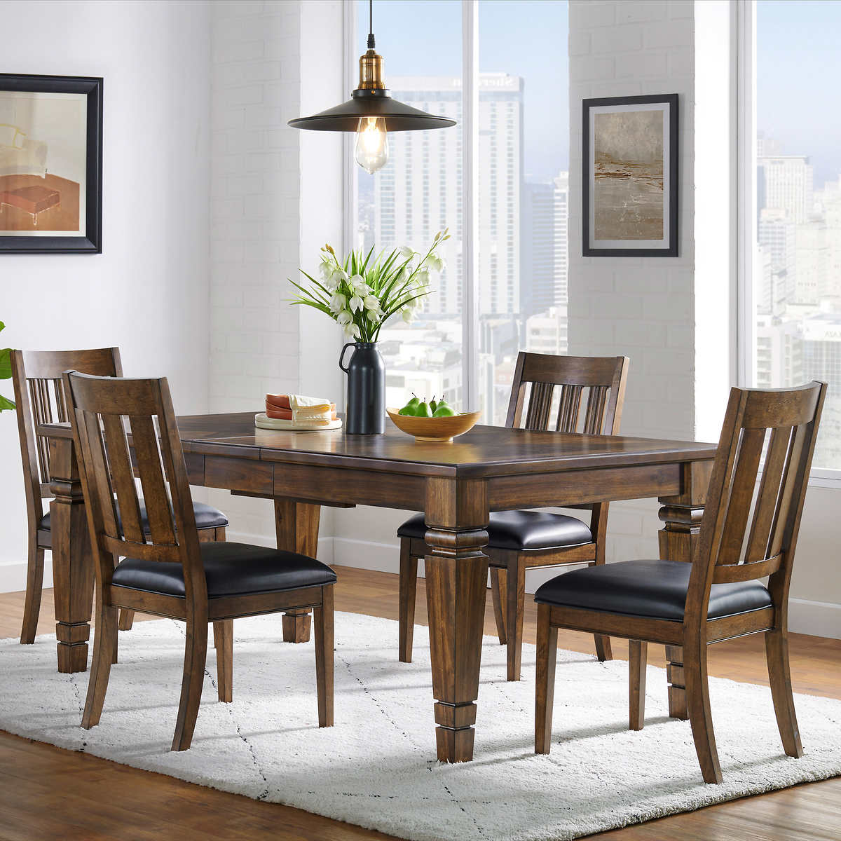
Where is my coffee?
It’s in the dining room.
It looks like a washing machine.

Slide 5
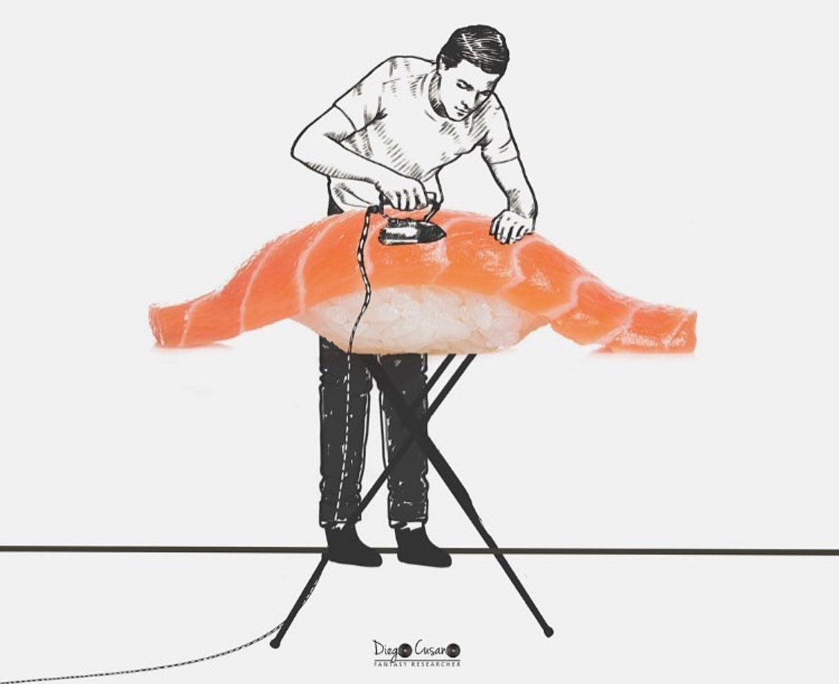
Where is my salmon sushi?
It’s in the bedroom.
It looks like an ironing board.

Slide 6
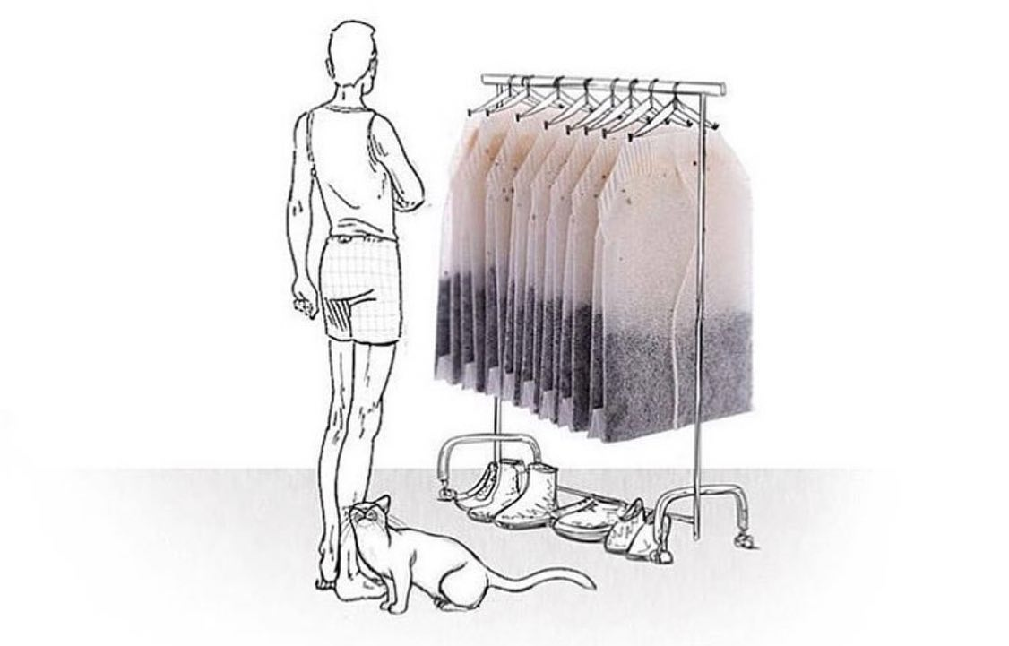
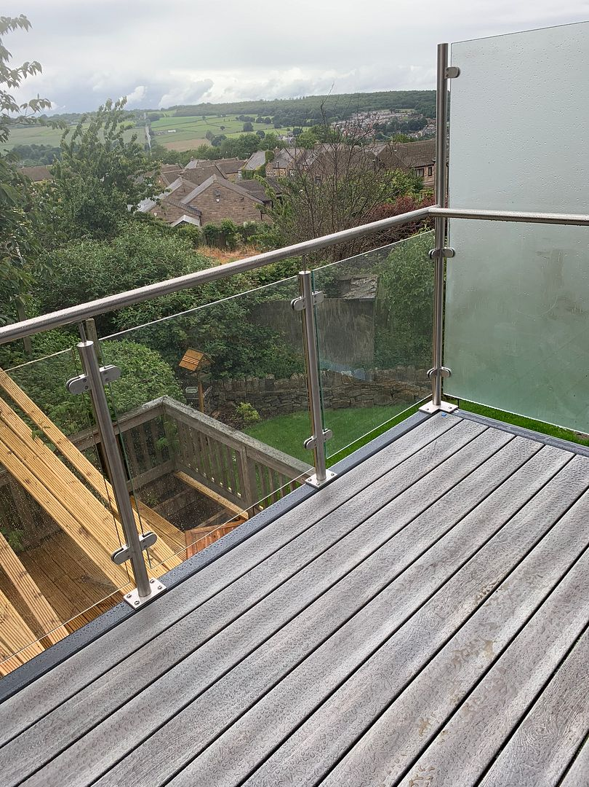
Where are my tea bags?
They’re in the balcony.
They look like clothes.

Slide 7
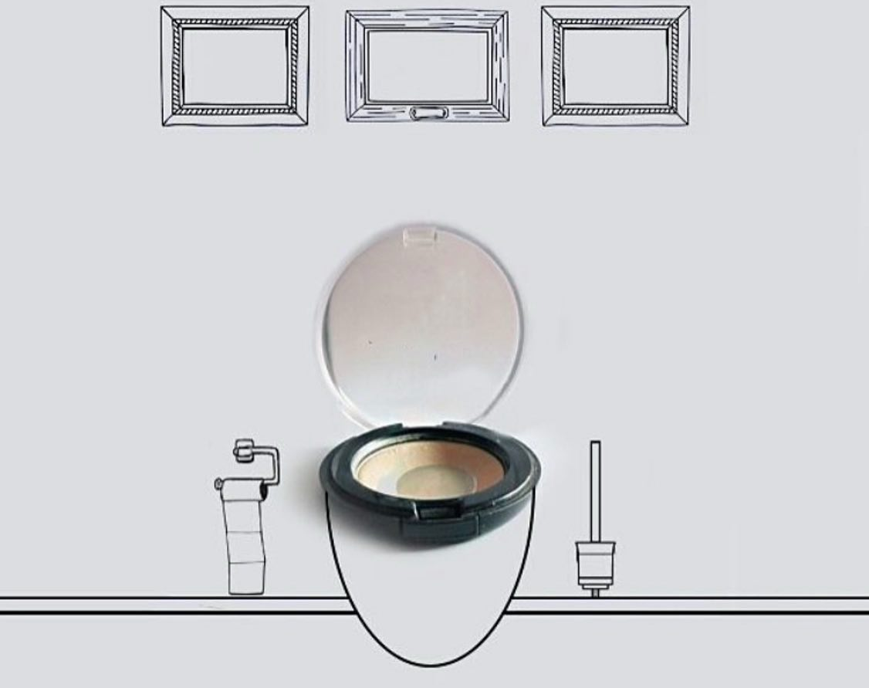
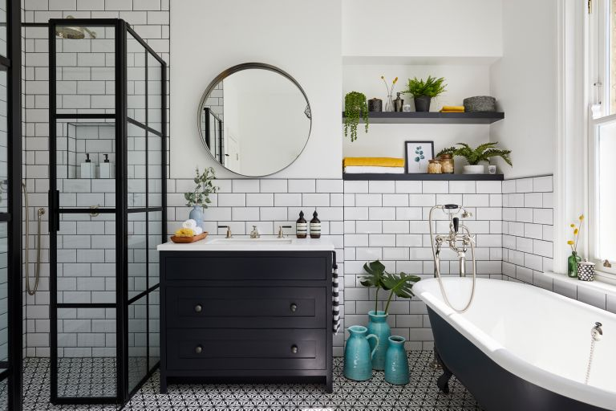
Where is my cup lid ?
It’s in the bathroom.
It looks like a toilet.

Slide 8
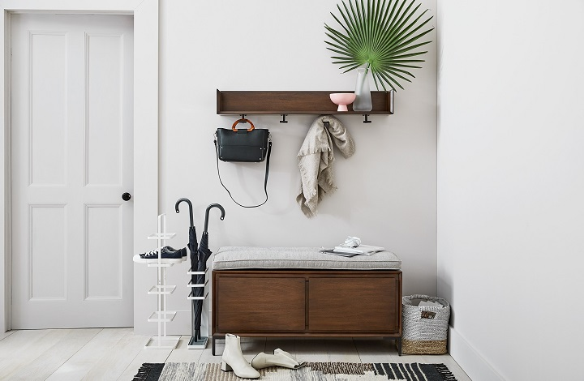
Where is my hat?
It’s in the entryway.
It looks like a pizza oven.

Slide 9
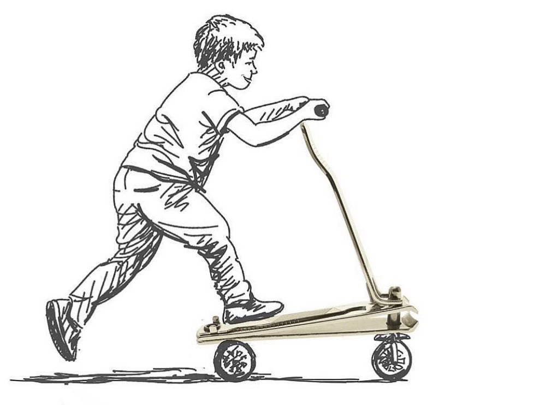
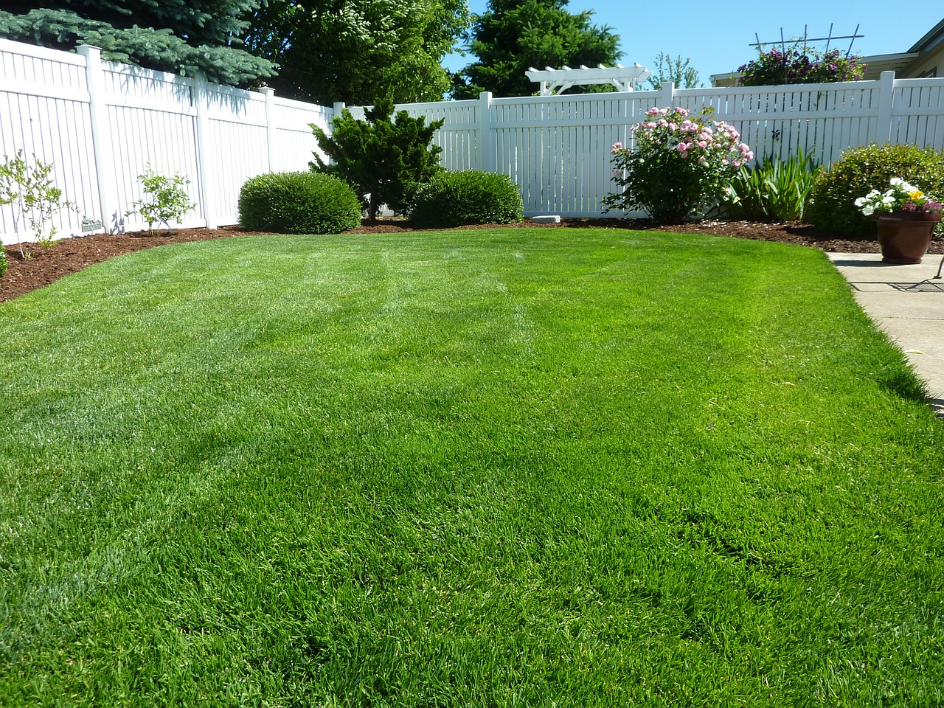
Where is my nail clipper?
It’s in the yard.
It looks like a scooter.

Slide 10
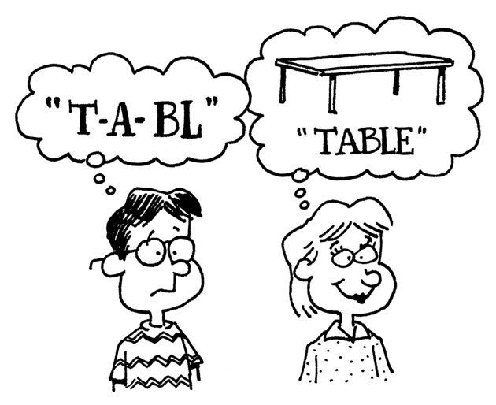
Phonics Time p50~51

Slide 11
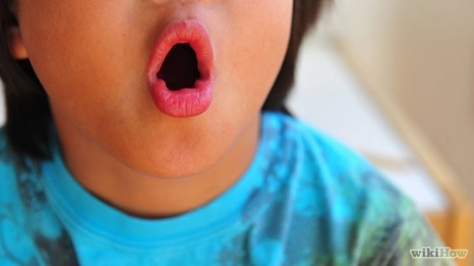
o
o
e

Slide 12
o

Slide 13
n
t
o

Slide 14
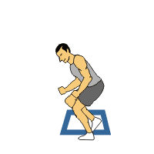
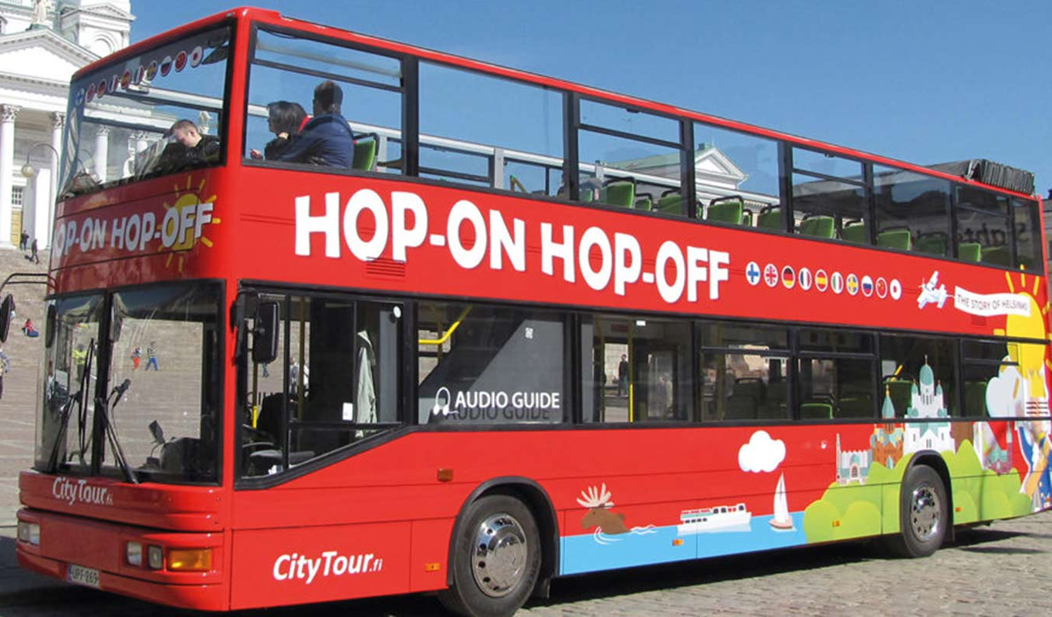
h
p
o

Slide 15
o
e

Slide 16
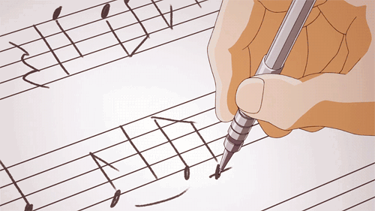
n
t
o
e

Slide 17
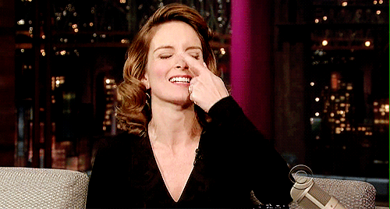
n
s
o
e

Slide 18
h
p
o
e

Slide 19
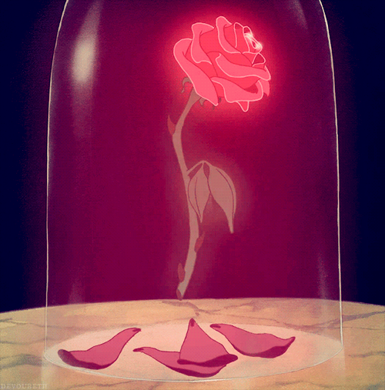
r
s
o
e

Slide 20
Tom can hop.
Bell cannot.
Tom hops to a rose.
He smells it with his nose.

Slide 21
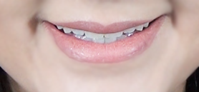
a
a
e

Slide 22
e
e
e

Slide 23
i
i
e

Slide 24
o
o
e

Slide 25
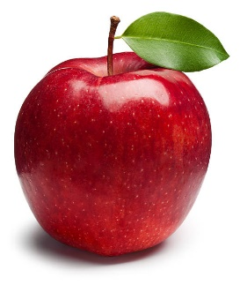
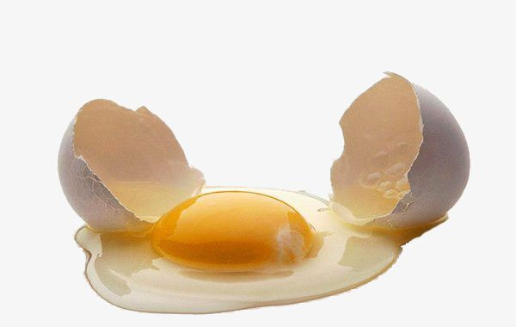
A
a
a
e
E
e
e
e
i
I
i
e
O
o
o
e

Slide 26
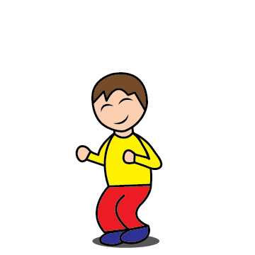
Now everybody. Stand up.
Listen to the word and raise your left hand or right hand.

Slide 27
o / o_e
hop

Slide 28
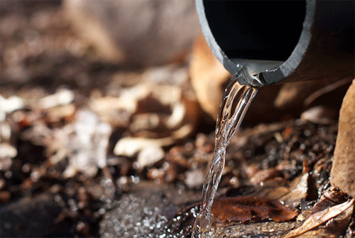
i / i_e
pipe

Slide 29
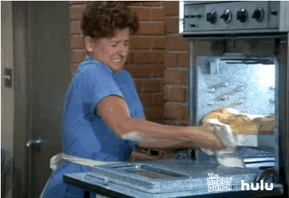
a / a_e
bake

Slide 30
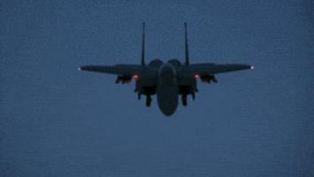
e / e_e
jet

Slide 31
i / e
lips

Slide 32
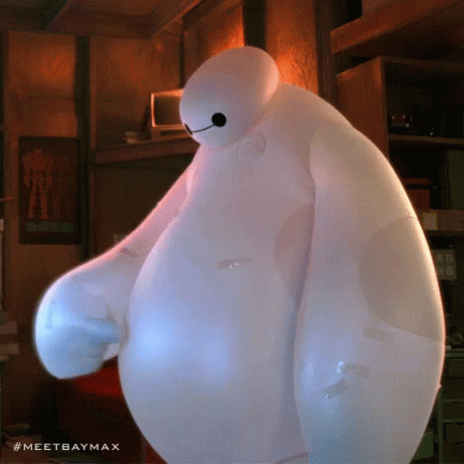
e / a
fat

Slide 33
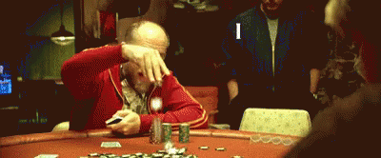
a / e
bet

Slide 34
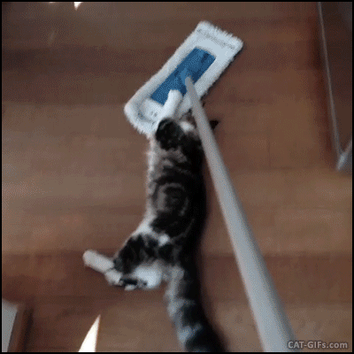
a / o
mop

Slide 35
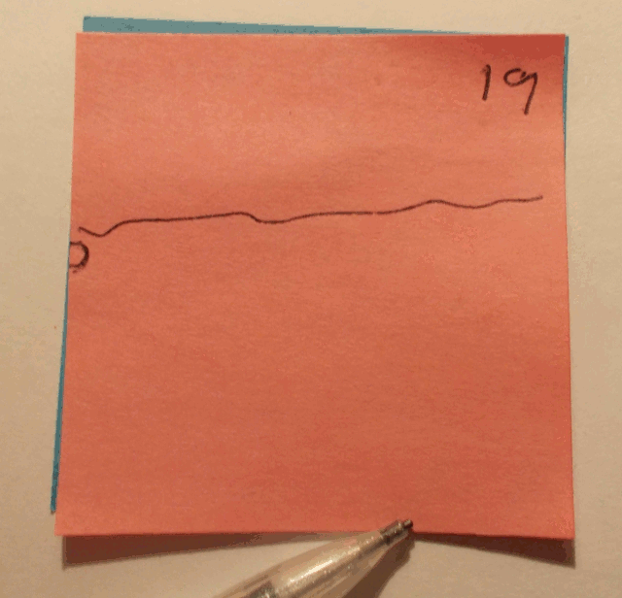
a_e / o_e
note

Slide 36
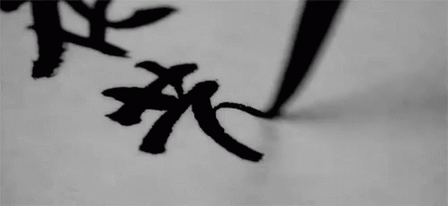
e_e / i_e
Chinese

Slide 37
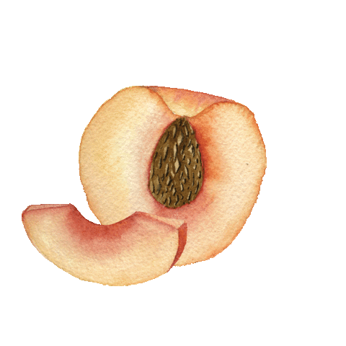
i / e_e
pip

Slide 38
a / o_e
Jack

Slide 39
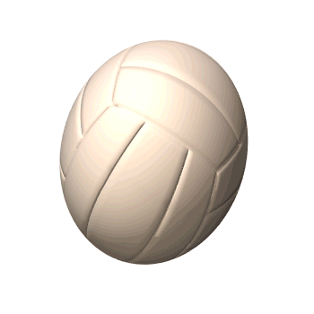
ball
a baseball
a pokéball
a basketball
a soccer ball
a volleyball

Slide 40
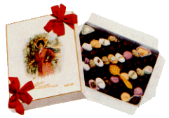
box
a candy box
a mail box
a gift box

Slide 41
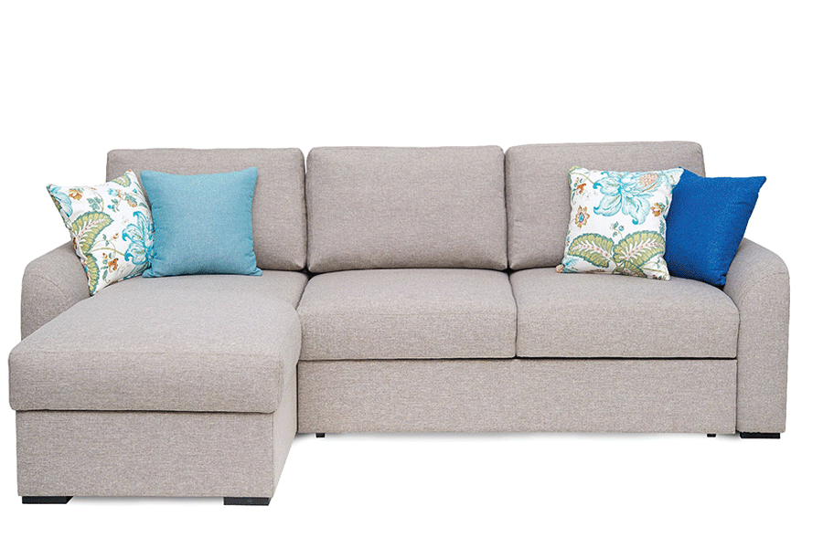
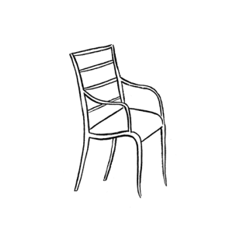
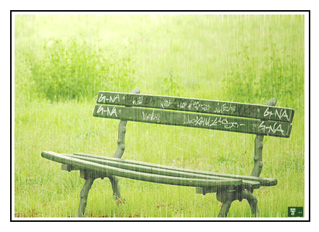
chair
a sofa
a bench

Slide 42
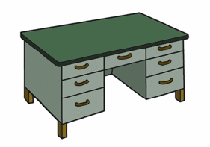
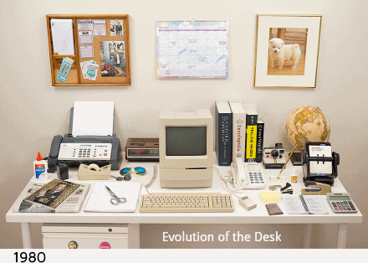
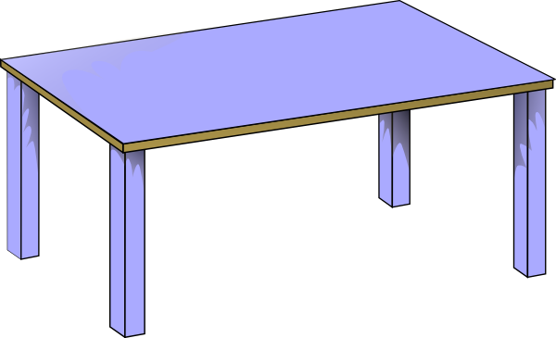
desk
a desk
a table

Slide 43
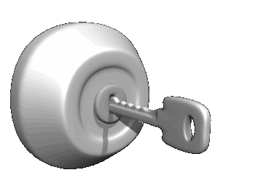
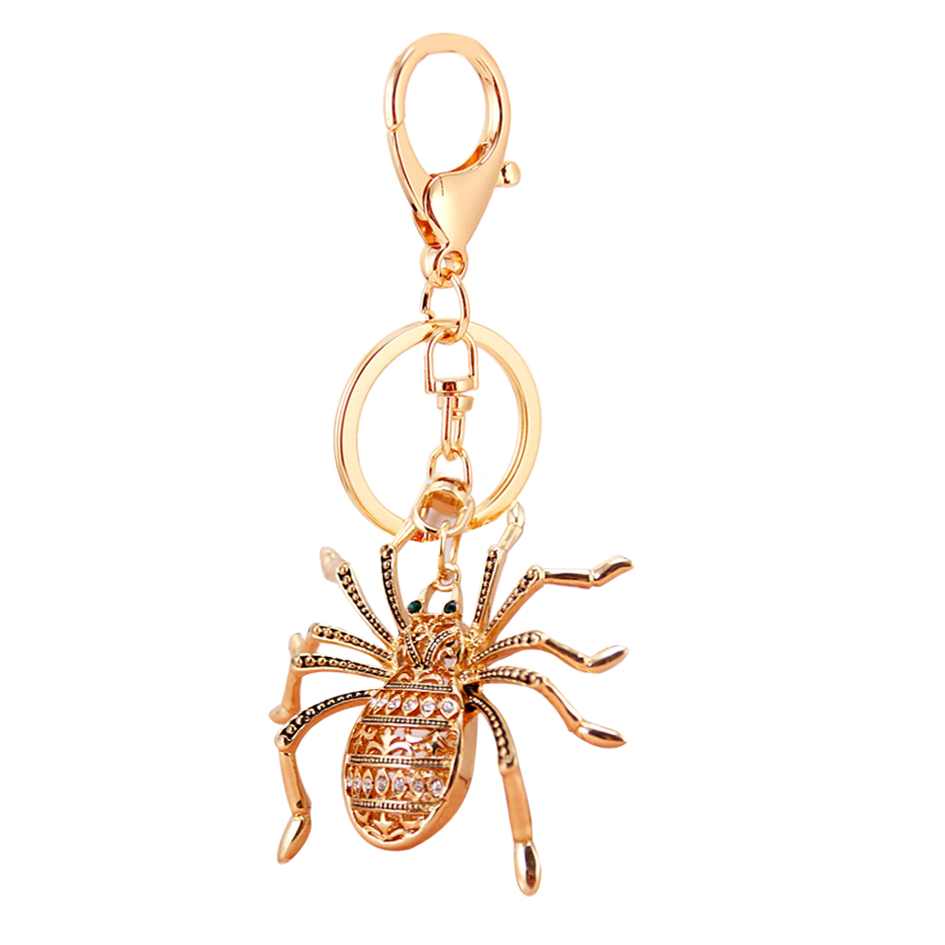
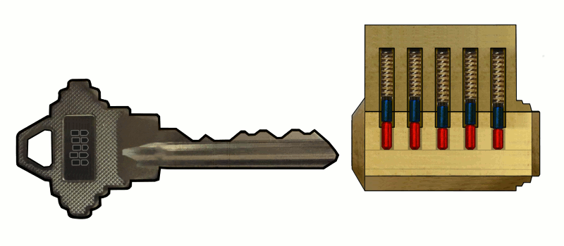
key
We can use the key to lock.
a key ring

Slide 44
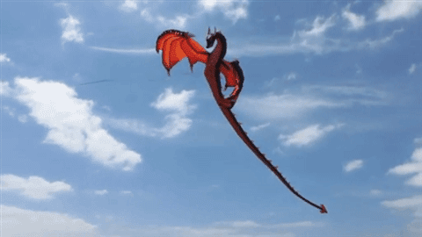
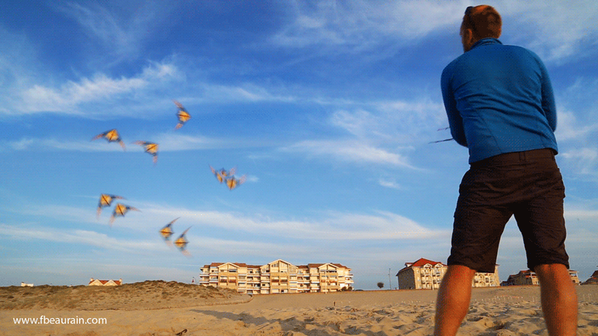
kite
fly a kite

Slide 45
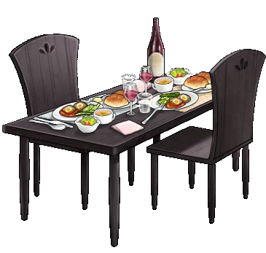
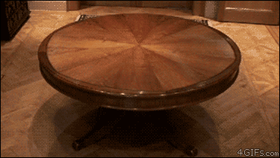
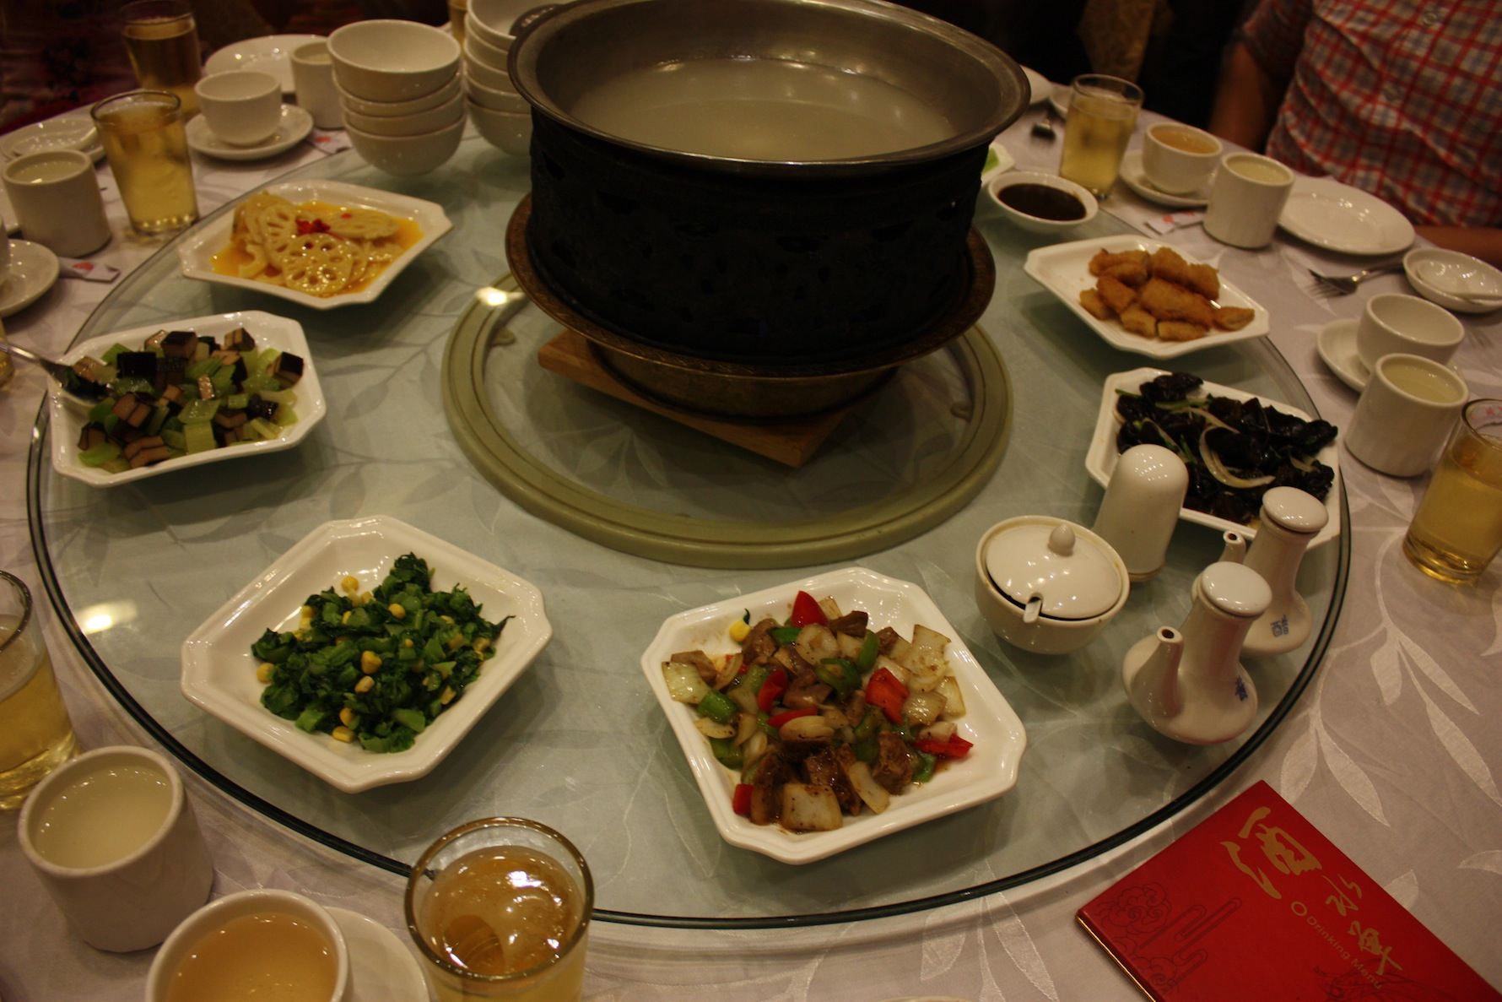
table
dining table
lazy Susan

Slide 46
a box
a ball
chairs
a key
a table
a kite
a desk

Slide 47
Take a guess. What’s this?

Slide 48
l
b
a
l

Slide 49
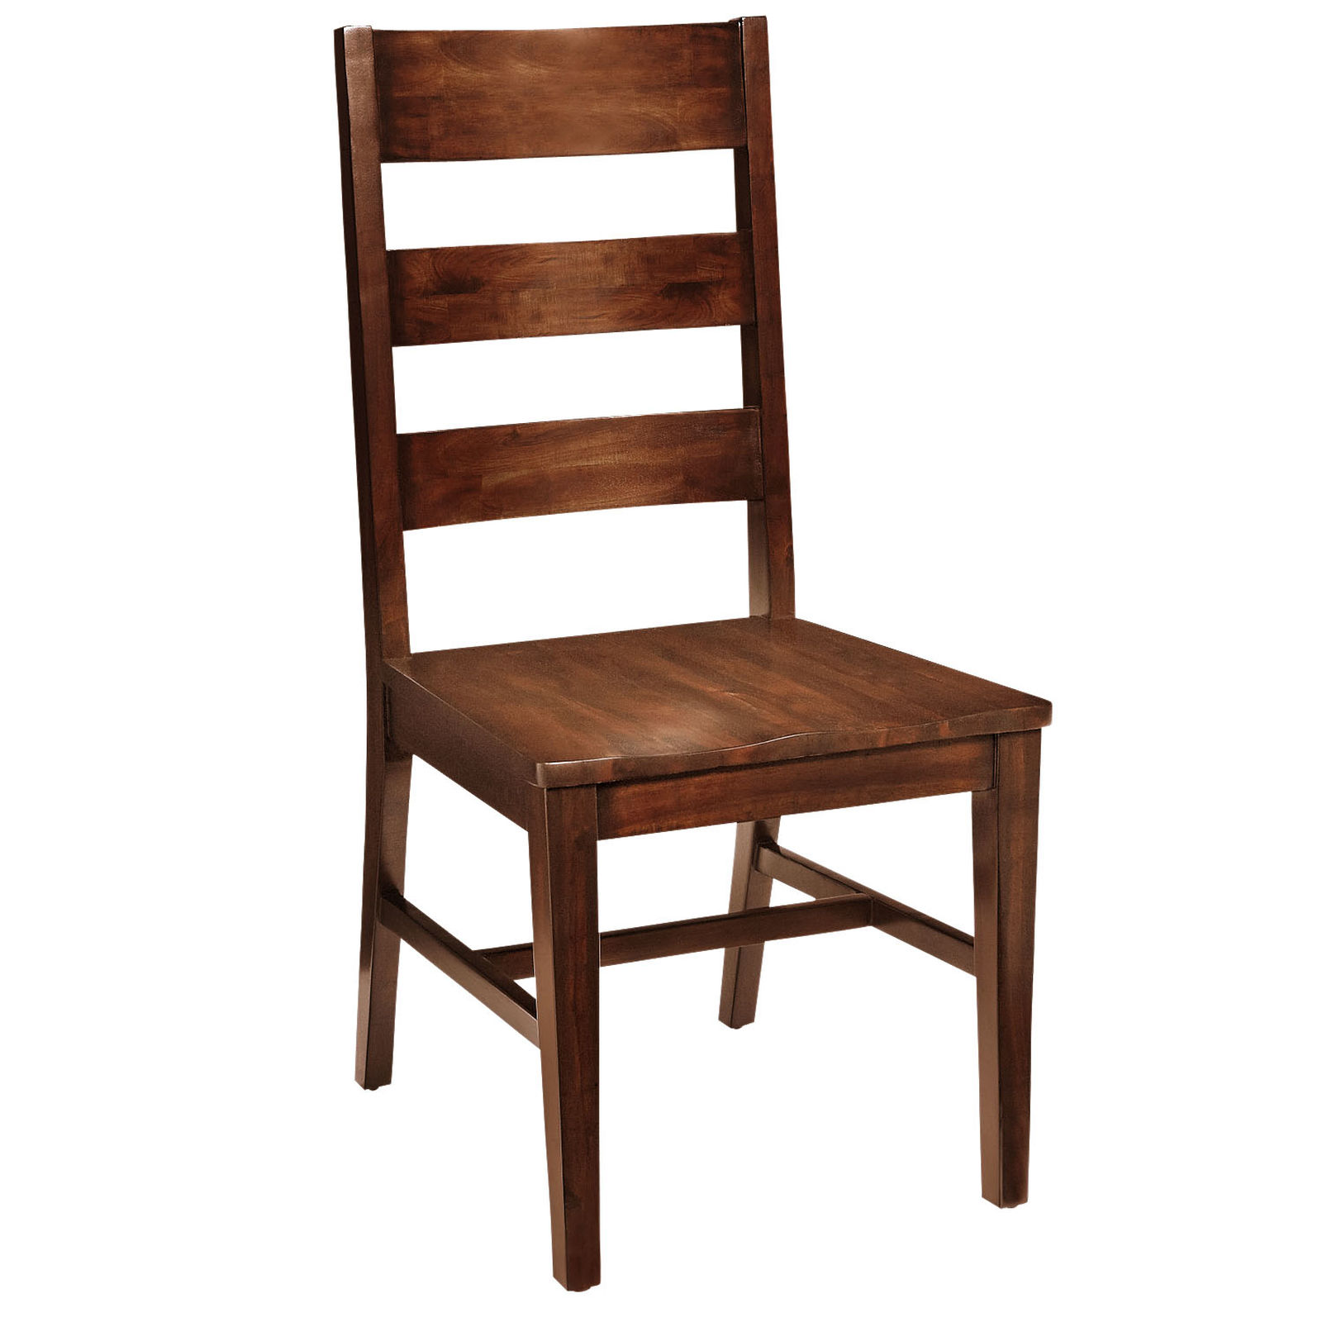
h
a
r
c
i

Slide 50
k
e
d
s

Slide 51
b
a
l
t
e

Slide 52
i
t
e
k

Slide 53
e
y
s
k

Slide 54
o
s
b
e
x

